Slide 1



The Egyptian E-Learning University
(EELU)
Faculty of Information Technology
E-Rent Application:
Streamlining Off-Campus Housing
Supervisor:
Dr. Rodaina.
Eng. Engy.

Slide 2
INTRODUCTION OF
OUR TEAM
Abdelrahman Mohamed Abdelkereem
Sohaila Alaa Eldin Fathy
Steven Ayman Salah
Eslam Yasser
Farag
21-01928
21-01856
21-01970
21-01932
Nourhan Omar Abdelmaksoud
Hager Mohamed
Abdelwhab
Hager Alaa Eldin Fathy
21-02126
21-02133
21-02132

Slide 3
Project Agenda
1
2
3
4
5
Introduction
Motivation
Problem Definition
Objectives
Methodology
6
7
8
9
10
Background(key feature)
Implementation
Tools and technology
Related Work
Design(UI & UX)
1
1
1
11
12
13
Demo
Conclusion
Future Work

Slide 4
Introduction
The ultimate solution to finding safe, affordable, and reliable off-campus housing for students. We understand the struggle of trying to secure a place to live while juggling studies and life on campus. Searching through multiple websites, dealing with unresponsive landlords, and worrying about scams can make the process overwhelming. That’s why E-Rent is here to simplify and streamline your housing search. Our platform is designed specifically with students in mind, offering a trusted, user-friendly space where you can easily find verified listings that meet your needs.

Slide 5
Motivation: Addressing Student Needs
Market Gap
01
Limited specialized student housing programs in Egypt create a pressing need for a solution.
Enhanced Experience
02
02
A user-friendly platform simplifies the search and booking process, reducing stress for students.
Positive Impact
03
The project aims to improve student lives by offering safe and suitable housing options.

Slide 6
Finding Off-Campus Housing: The Challenges and Our Solution
Problem
Solution
The mobile app aims to address these challenges by offering a centralized platform for finding perfect matches between students and landlords, connecting with compatible roommates, and securely booking off-campus housing.
Students face challenges like finding suitable housing, communication inefficiencies, roommate compatibility issues, and insecure booking processes.

Slide 7



Project Objectives
Facilitate Housing Search
Streamline Rental Process
Improve Search Accuracy
Provide a search interface with criteria like location, price, and amenities.
Allow students to book housing and make payments through the app, offering rental management tools.
Use AI to analyze user preferences and provide personalized search results.

Slide 8






Methodology
Build the application, design the database, and integrate features.
Develop and train AI models on user data.
Publish the application on app stores (Google Play and App Store).
Collect user requirements and define core features.
Development
LAUNCH
Requirements Gathering
Maintenance and Updates
Testing
Design
Regularly fix bugs and update the application and models.
Test the application and models to ensure they are error-free and perform effectively..
Create UI designs and system architecture.

Slide 9
Key feature:
Advanced Housing Search
Filter Options
AI-Powered Smart Filter
Filter results based on location, price, and size.
Display detailed housing information with images and comprehensive descriptions.
Delivers personalized results based on user preferences and behavior.
Utilizes artificial intelligence to enhance the housing search process in a smart and efficient way.

Slide 10
Booking and Payment System
Complete Bookings
Payment Methods
Students can complete the entire booking process within the app, eliminating the need for external communication.
The app will support various payment methods, including credit cards and popular digital wallets, to provide user convenience and security.

Slide 11


Internal Communication
Instant Notifications
Feedback
The student can write comments and rate on the
accommodation.
Instant notifications for new messages.

Slide 12
Recommendation System
Content-Based Filtering
Hybrid System
Based on university and use preferences and item features,
suggesting items similar to previous interactions.
Combining content-based and collaborative filtering for more personalized recommendations.
Collaborative Filtering
Rule-Based System
Recommending items based on similar user preferences
and past behavior.
Emulates human decision-making by applying predefined "if-else" rules to input data, allowing it to solve problems and derive conclusions like an expert.

Slide 13
Rule-Based Systems VS Machine Learning
 | Rule Base System | Machine Learning
 | Use predefined rules to make decisions or solve problems. Rules are typically expressed in "if-else" format | Involves algorithms that learn from data to make predictions or decisions without explicit programming of rules.
 | Maintenance Performance Data Dependency | Complexity Data Dependency
 | Simplicity Control Consistency | Flexibility Automation Pattern Recognition
 | Scalability Limited Flexibility Knowledge Erosion | Interpretability Data Requirements Overfitting:
Definition
Characteristics
Advantages
Disadvantages

Slide 14
Rule-Based System
How it works
The recommend_housing function evaluates housing options by checking criteria such as budget, required amenities, size, gender, and faculty cluster. It provides recommendations in stages, relaxing constraints if no exact matches are found, and outputs reasons for any rejections.

Slide 15
Key Component
1. Data Import : Loads housing data from a CSV file using Pandas.
Transforms data into a list of dictionaries for easy access.
2. Faculty Clustering : Organizes faculties into broader clusters (e.g., Medical, Engineering).
Streamlines matching by aligning housing with academic disciplines.
3. Recommendation Process :
Stage 1: Searches for exact matches based on all criteria.
Stage 2: Relaxes faculty and type constraints to find alternatives.
Stage 3: Matches only budget and gender, ignoring other factors.
4. Rejection Tracking :
Records reasons for rejected options.
Adds transparency and aids informed decision-making.
5. Testing and Validation :
Includes test cases to demonstrate functionality.
Show cases adaptability to diverse student needs.

Slide 16
Testing & Evaluation
Manual Test Cases :
includes 4 test cases
The goal of these test cases is to ensure the housing recommendation engine can :
Handle flexible and strict preferences
Filter results based on amenities, size , and housing types
Respect budget constraints and prioritize affordability
Adapt to different genders and academic faculties
Remain functional and reliable when presented with invalid or incomplete data

Slide 17
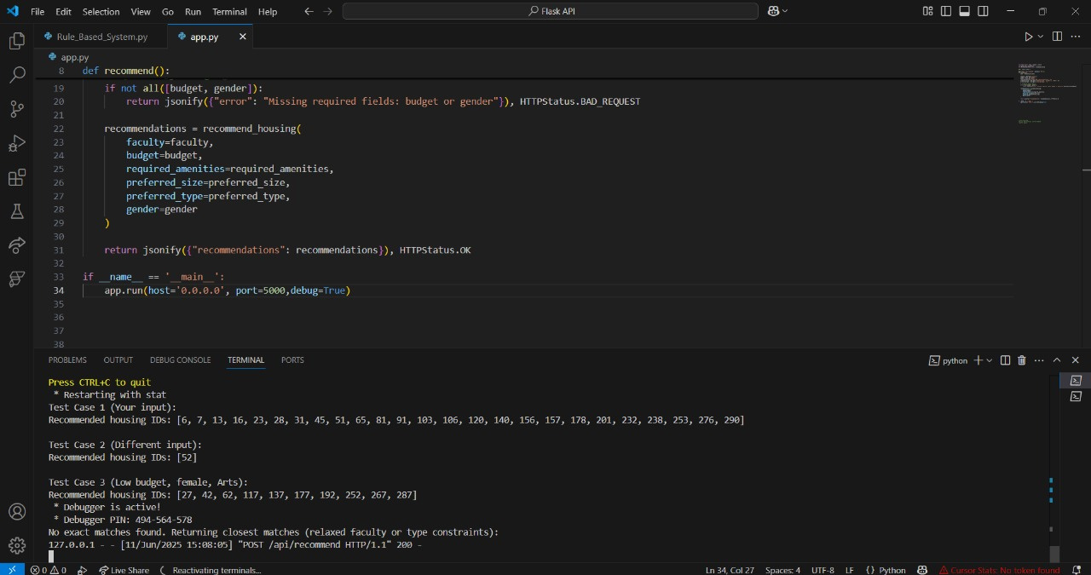
Testing Code
# Test Case 1: Computer Science student
student1 = {
"faculty": "Computer Science",
"budget": 1500,
"required_amenities": ["wifi"],
"preferred_size": {"rooms": 1, "beds": 1},
"preferred_type": "",
"gender": "male"
}
print("Test Case 1 Results:")
recommended_housing1 = recommend_housing(**student1)
# Calls the rule-based function
print("Recommended IDs:", recommended_housing1)

Slide 18
Api
The API is designed to receive user data in JSON format — including fields like gender, budget, and then call a recommendation function that processes the input and returns the most suitable housing options.
How Api works
In FlutterFlow, we configured an API Call by inserting the ngrok-generated URL, setting the method to POST, and providing a sample JSON body for testing. This setup allows FlutterFlow to send requests directly to the local API and receive responses in real time

Slide 19
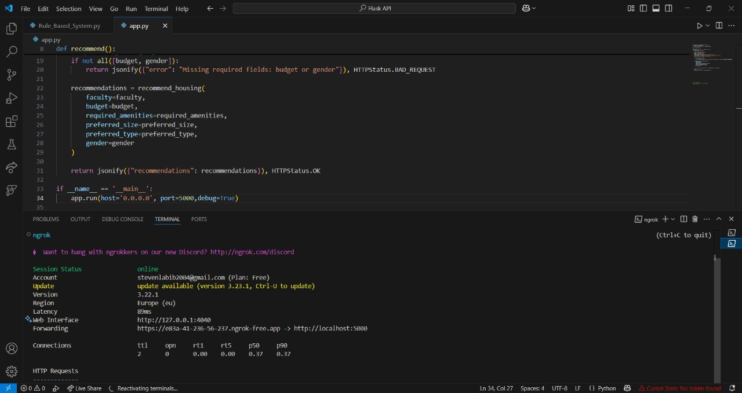
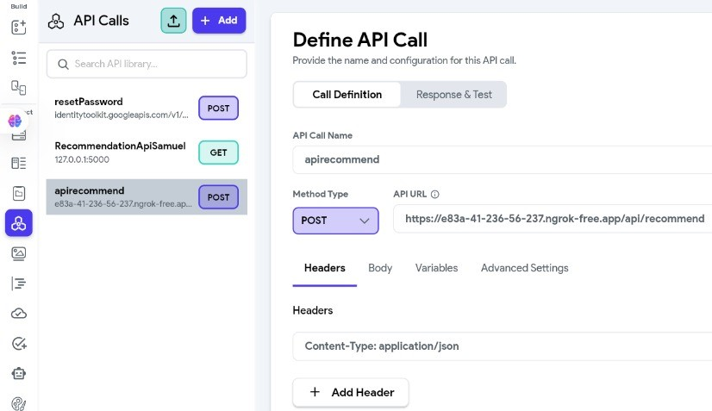
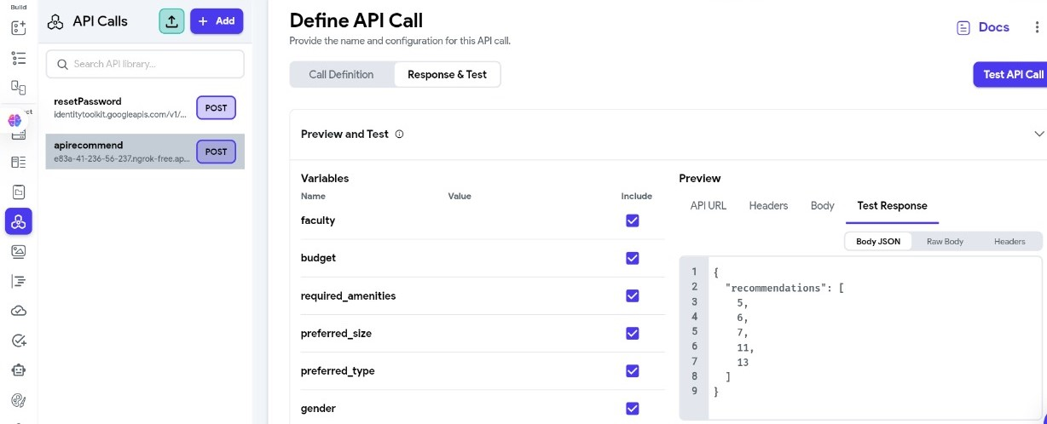
Api Integration

Slide 20






Implementation:
Tools and Technologies
Front-end
Back-end
Design Tools
UI & UX
AI Integration
API

Slide 21


Related Work(Similar System)
local systems:
Dubizzle (EG OLX)
بيوت مصر (Beyout Misr)
Pros:
1- easy-to-use interface
2- efficient searches
3- integrated payments
Cons:
1- Security issues with fake listings
2- dominance of paid ads over organic content
3- location accuracy problems.
Pros:
1- Simplifies rental management
2- improves property comparisons
3- protects user privacy
4- focused on apartments.
Cons:
1- Limited market recognition as a newer platform
2- challenges with brokers

Slide 22


Global System:
Airbnb
Sakan
Pros:
1-flexible pricing
2-user reviews
3-diverse accommodation options
Cons:
1-Primarily targets major cities
2- Hidden fees
3-Regulatory hurdles and complex user experience.
Pros:
1-Wide range of authentic listings
2-allows saving favorite properties
Cons:
1-Potential for outdated listings
2- high competition
3- limited geographic reach
4- technical support issues.

Slide 23
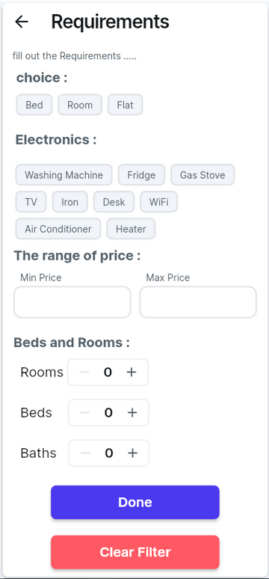
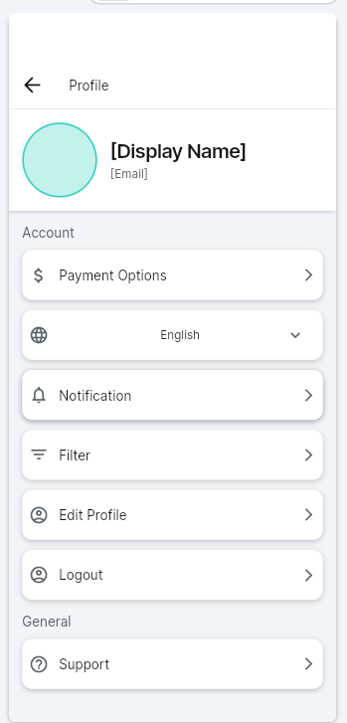
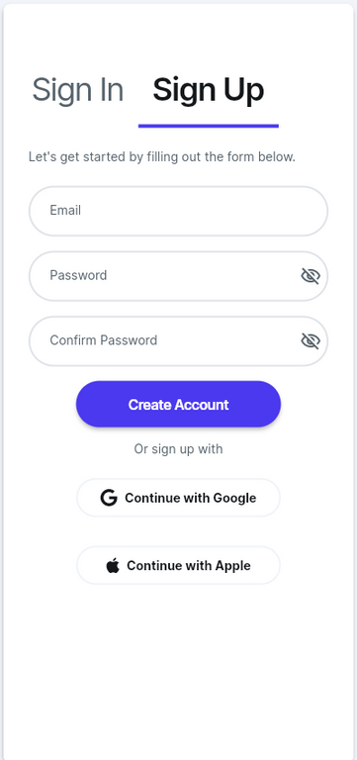
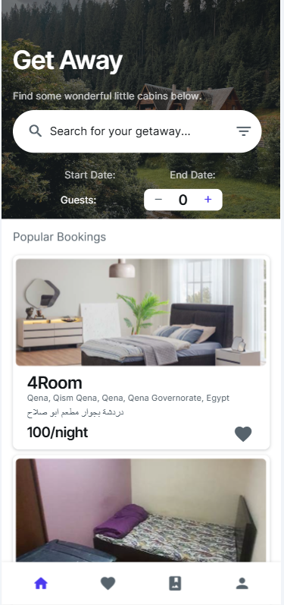
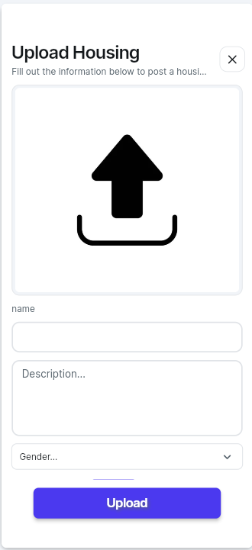
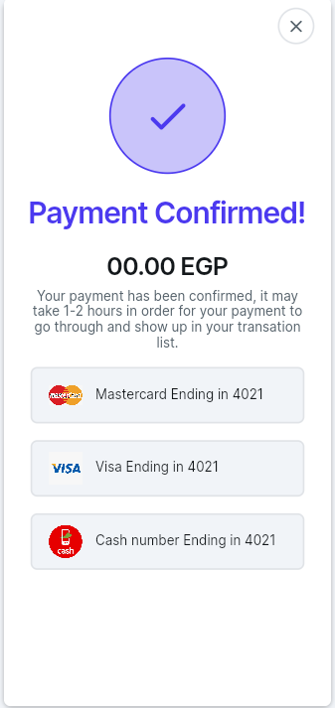
UI & UX

Slide 24
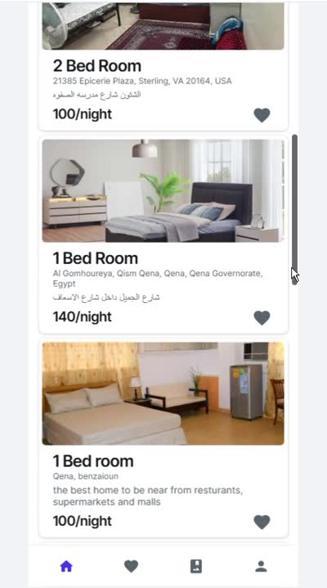
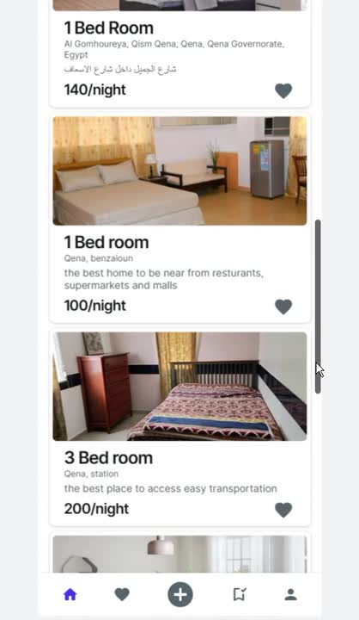
DEMO
Student
Owner

Slide 25
Conclusion
This application aims to provide an innovative solution to help students find housing easily , suitable and securely , enhancing their experience with AI technologies.
Combining Flutter, Firebase, and AI integration offers a seamless experience that brings search, booking, and payment together in a smart, convenient platform.

Slide 26
Future Work
1
Continuous updating
2
Video preview of real estate
3
Direct communication
Multi- language support
4

Slide 27

Thank You!!

